Slide 1
Lab Leak

Slide 2
IDA pro (Windows Only)
https://drive.google.com/file/d/0B5w3KuqR3zoBZVk2SmR0NVJ6X2c/view

Slide 3
題目要求
Leak
1. Canary
2. Stack
3. PIE
4. Libc
5. Secret
Leak all and get flag.

Slide 4
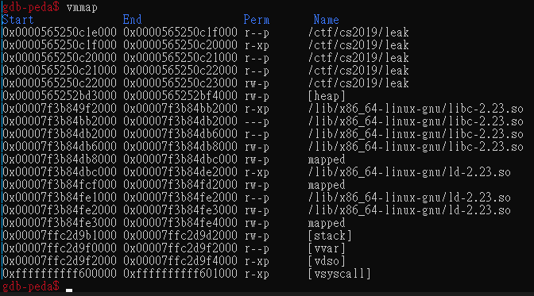
0x0
PIE Base
Text
Bss
Heap Base
Heap
Libc Base
Libc.so
ld.so
Stack Base
Stack
0xffffffffffffffff

Slide 5


PIE Example
Command line :readelf -a leak | grep main
Real position
Real position = PIE Base + 0x1b5f

Slide 6
Libc Example
Command line :readelf -a /use/lib/x86_64-linux-gnu/libc-2.29.so | grep system
Real position
vmmap
Real position = Libc Base + 0x52fd0

Slide 7
Canary
Buf
Local Variable
Stack Frame
Canary
0x934c0e79c926cd00
Old Rbp
Return Address

Slide 8
Canary
If Buf can buffer overflow
Input lots of ‘A’
Buf
Local Variable
Canary
0x934c0e79c926cd00
Old Rbp
Return Address

Slide 9
Canary
Before return, it will check canary value is correct or not:
0x4141414141414141 != 0x934c0e79c926cd00
If stack smash detect -> abort
Buf
Local Variable
AAAAAAA……
Canary
Canary(0xfaceboocboocface)
0x4141414141414141
Old Rbp
Return Address

Slide 10
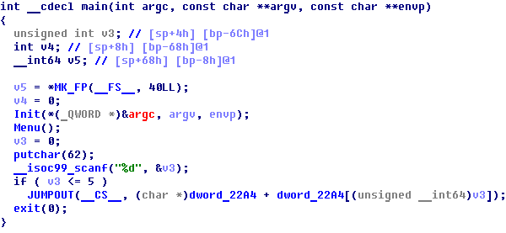
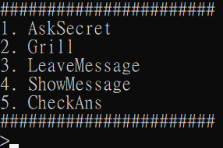
Need a little bit reverse
Use IDA to decompile

Slide 11
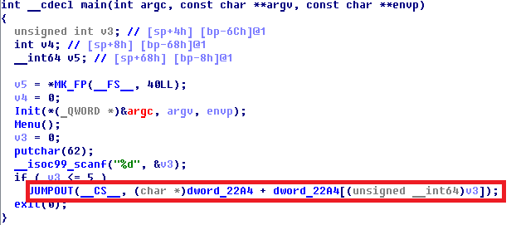
Jump table is hard to reverse
Switch case use jump table to calculate the jump address.

Slide 12
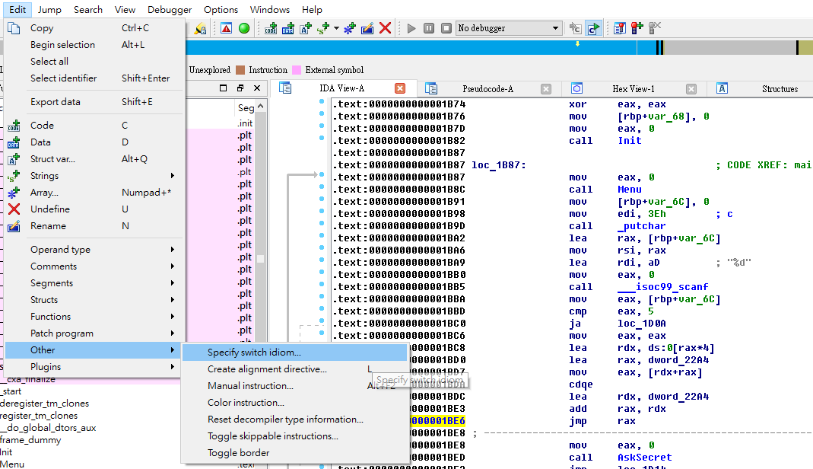
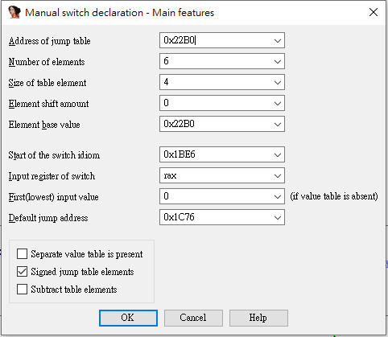

Slide 13
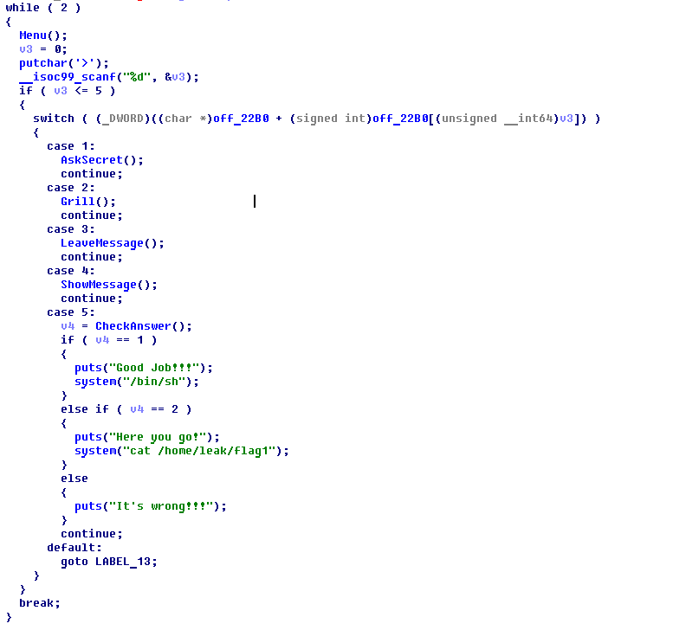

Slide 14
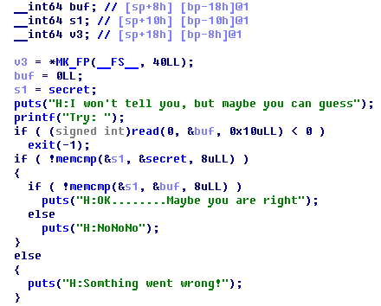
Secret
AskSecret()
secret is a random value stored in bss.
buf is GuessSecret
s1 is TempSecret
1. Store secret in s1 (GuessSecret)
2. Read input in buf (TempSecret)
3. Compare s1 with secret, check they are the same.
4. Compare s1 with buf, check they are the same.

Slide 15
Secret
AskSecret()
1.buf (GuessSecret) size is 8 byte
2.read() with 0x10 bytes at buf (GuessSecret),
so we can overflow s1 (TempSecret).
3.We can partial overwrite s1 (TempSecret)
and check the output is “NoNoNo”
or “Something went wrong”

Slide 16
Secret
Secret = 0x1122334455667788
Secret[8]
88 | 77 | 66 | 55 | 44 | 33 | 22 | 11
GuessSecret[8]
TempSecret[8]
88 | 77 | 66 | 55 | 44 | 33 | 22 | 11

Slide 17
Secret – case 1
Secret = 0x1122334455667788
Oveflow GuessSecret with ‘A’*8+chr(0)
Output will be “Something went wrong”
You can guess Secret with
‘A’*8+chr(0) ~ ‘A’*8+chr(255)
Secret[8]
88 | 77 | 66 | 55 | 44 | 33 | 22 | 11
GuessSecret[8]
41 | 41 | 41 | 41 | 41 | 41 | 41 | 41
TempSecret[8]
00 | 77 | 66 | 55 | 44 | 33 | 22 | 11

Slide 18
Secret – case 2
Secret = 0x1122334455667788
Oveflow GuestSecret with ‘A’*8+chr(0x88)
Output will be “NoNoNo”
So we know first byte of secret is 0x88
And we can test next byte of secret
Secret[8]
88 | 77 | 66 | 55 | 44 | 33 | 22 | 11
GuessSecret[8]
41 | 41 | 41 | 41 | 41 | 41 | 41 | 41
TempSecret[8]
88 | 77 | 66 | 55 | 44 | 33 | 22 | 11

Slide 19
Secret
Secret = 0x1122334455667788
Oveflow GuestSecret with
‘A’*8 + ‘\x88’+chr(0) and try
Secret[8]
88 | 77 | 66 | 55 | 44 | 33 | 22 | 11
GuessSecret[8]
41 | 41 | 41 | 41 | 41 | 41 | 41 | 41
TempSecret[8]
88 | 00 | 66 | 55 | 44 | 33 | 22 | 11

Slide 20
Secret
Worst case 256*8 = 2048 will leak all secret

Slide 21
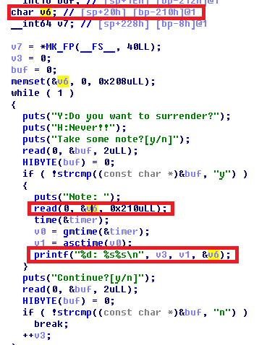
Canary and Stack
Grill()
v6 (TempBuffer, at rbp-0x210) size is 0x208
read() with 0x210 bytes at v6 (TempBuffer)
We can overflow canary (at rbp-0x8) with read()

Slide 22
Canary and Stack
canary = 0x934c0e79c926cd00
old rbp = 0x00007ffc5b552f70
The last byte of canary must be 0x00
Stack memory of Grill()
TempBuffer[0x208]
(rbp-0x210)
AAAAA….
AAAAA….
AAAAA….
AAAAA….
AAAAA….
canary(rbp-0x8)
00 | cd | 26 | c9 | 79 | 0e | 4c | 93
old rbp(rbp)
70 | 2f | 55 | 5b | fc | 7f | 00 | 00

Slide 23
Canary and Stack
If we give ‘A’*0x208 + ‘B’ to read()
Now printf("%d: %s%s\n",
iCounter,asctime(gmtime(&timep)),TempBuffer)
It will print
“A”*0x208 + “\x42\xcd\x26\xc9\x79\x0e\x4c\x93
\x70\x2f\x55\x5b\xfc\x7f”
Leak Canary and Stack!!!
P.S:
You need to overflow again and make first byte of canary
to be 0x00, otherwise stack smash detect
Stack memory of Grill()
TempBuffer[0x208]
AAAAA….
AAAAA….
AAAAA….
AAAAA….
AAAAA….
canary (rbp-0x8)
42 | cd | 26 | c9 | 79 | 0e | 4c | 93
old rbp (rbp)
70 | 2f | 55 | 5b | fc | 7f | 00 | 00

Slide 24
Homework Hint
Use Grill + Leave Message + Show Message
It’s about stack frame

Slide 25
Memory after call Grill()
LeaveMessage
‘A’*0x28+
’B’*0x20+
’\x00’
buffer[0x20](rbp-0x210)
‘C’*0x20
TempBuffer[0x208]
(rbp-0x210)
Padding[0x1e0]
(rbp-0x1f0, uninitialized)
‘A’*0x8+’B’*0x20+’\x00’
read(0,buffer,0x20) in LeaveMessage()

Slide 26
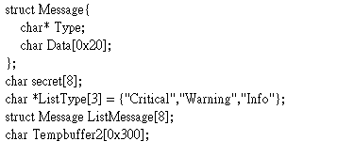
LeaveMessage
Buffer[0x20](rbp-0x210)
‘C’*0x20
It will calculate iLength = strlen(buffer);
strlen will count until ‘\x00’
iLength will be 0x48 (0x20+0x8+0x20)
Then memcpy(ListMessage[0].Data,buffer,iLength);
It will copy ‘C’*0x20+’A’*0x8+’B’*0x20 to ListMessage[0].Data
‘B’*0x20+’\x00’
Padding[0x1e0]
(rbp-0x1f0, uninitialized)
‘A’*0x8

Slide 27
LeaveMessage
ListMessage[8]
Buffer[0x20](rbp-0x210)
‘C’*0x20
ListMessage[0].Type
ptr to “Critical”
ListMessage[0].Data
‘C’*0x20
Padding[0x1e0]
(uninitialized)
‘B’*0x20+’\x00’
‘A’*8
ListMessage[1].Type
‘A’*8
ListMessage[1].Data
‘B’*0x20
…
Copy from buffer to ListMessage[0].Data

Slide 28
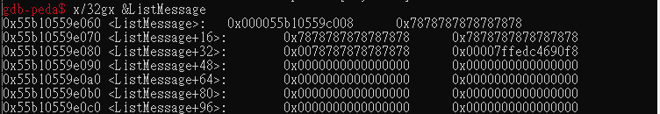
ListMessage[0].Type
ptr to “Critical”
ListMessage[0].Data
‘C’*0x20
You can modify ‘A’*8 to a pointer value of PIE or libc
Then use showMessage to print ListMessage[1],
it will print PIE or libc for you
You can use return address(return_addr) in stack frame to leak PIE
0x7ffedc4690f8 is the address of return_addr in stack frame
ListMessage[1].Type
ptr to where you want to leak
ListMessage[1].Data
‘B’*0x20
…

Slide 29
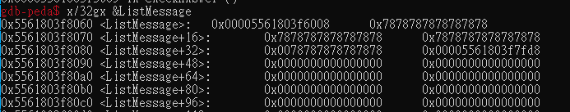
ListMessage[0].Type
ptr to “Critical”
ListMessage[0].Data
‘C’*0x20
You can modify ‘A’*8 to a pointer value of PIE or libc
Then use showMessage to print ListMessage[1],
it will print PIE or libc for you
You can use GOT of system in bss segment to leak libc
0x5561803f7fd8 is the address of GOT of system
ListMessage[1].Type
ptr to where you want to leak
ListMessage[1].Data
‘B’*0x20
…

Slide 30
Have Fun!!

